Slide 1


Slide 2
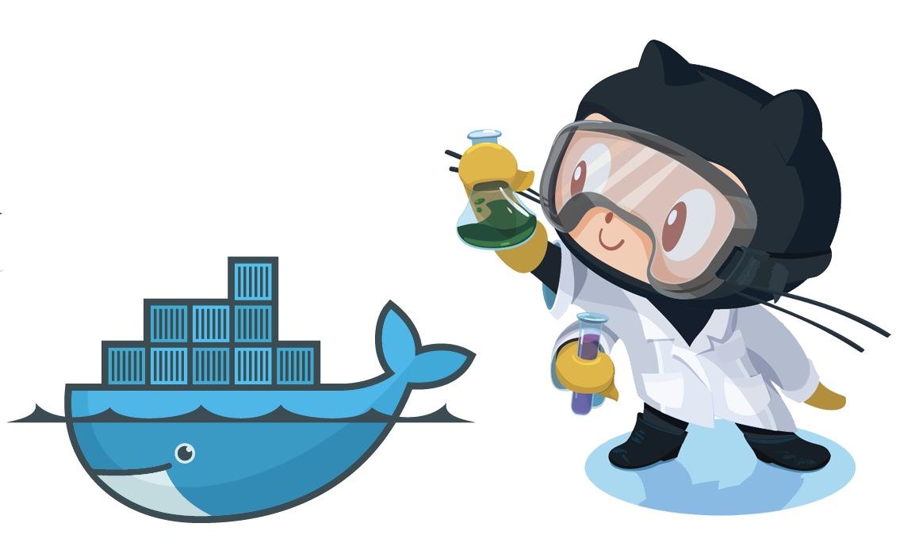
Código fonte
https://github.com/MarcosCordeiro/workshop-docker

Slide 3
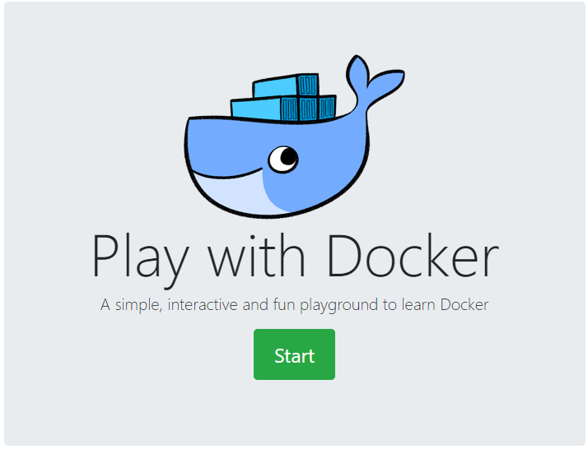
Play with docker
https://labs.play-with-docker.com/

Slide 4

What is Docker?
History
What is not Docker
What is Docker
Docker Linux
Docker Windows
Docker ARM
Nvidia-Docker
Benefits
Other options
RKT, LXC – LXD, Apache Mesos, OpenVZ, etc…

Slide 5
Notes:
<number>

Slide 6
What is and what is not Docker?
"Docker is not a traditional virtualization system. While in a traditional virtualization environment we have an OS. complete and isolated, within Docker we have isolated resources that using common kernel libraries (between host and container), this is possible because Docker uses its own lib called libcontainer as a backend.”

Slide 7
libcontainer
Libcontainer provides a native Go implementation to create containers with namespaces, cgroups, capabilities,
and filesystem access controls.
It allows you to manage the lifecycle of the container that performs additional operations after the container is created.
Notes:
<number>

Slide 8
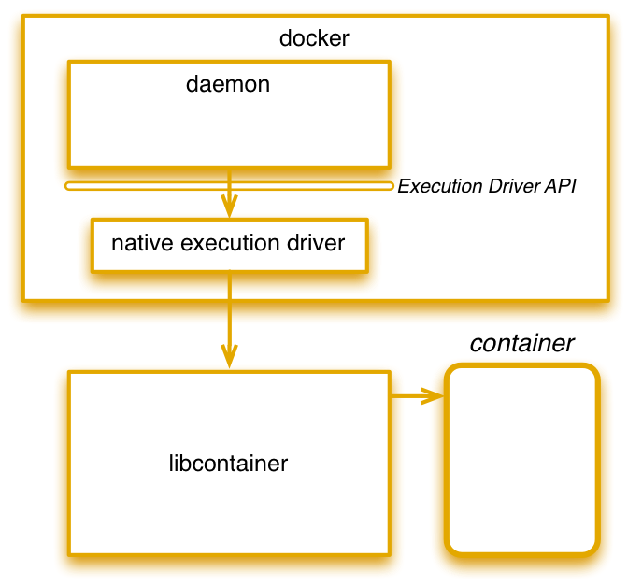
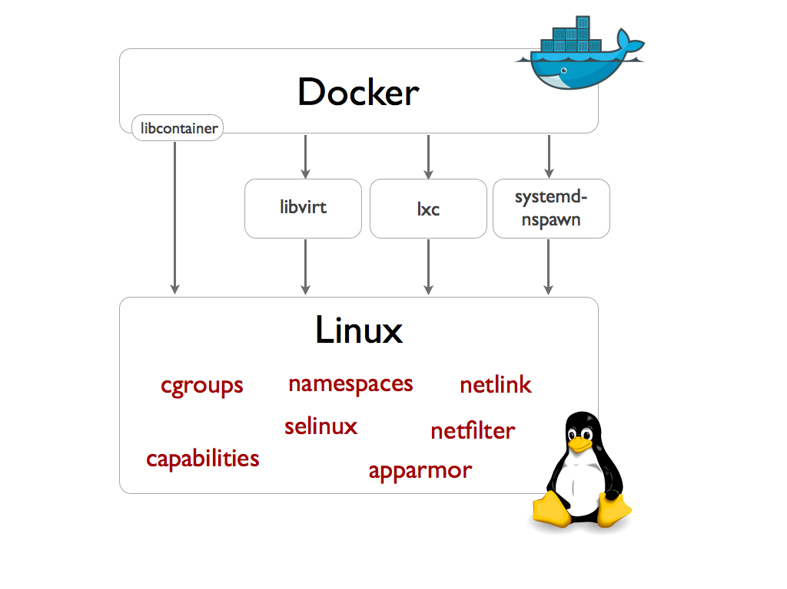
libcontainer
Notes:
<number>

Slide 9
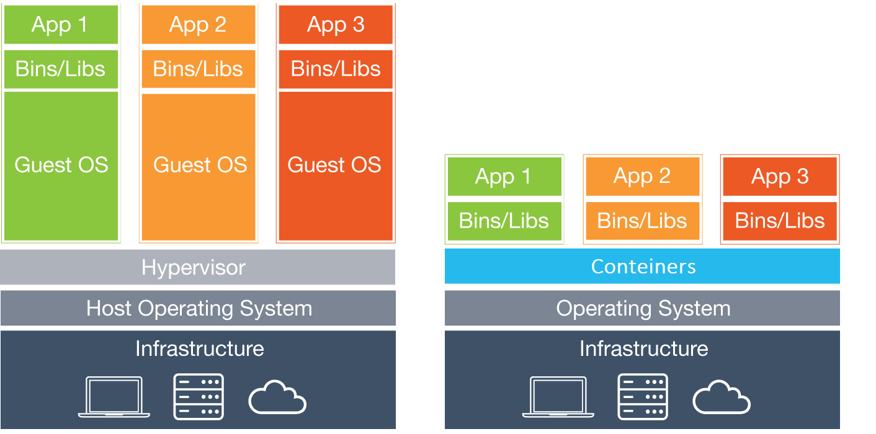
virtualization
container

Slide 10
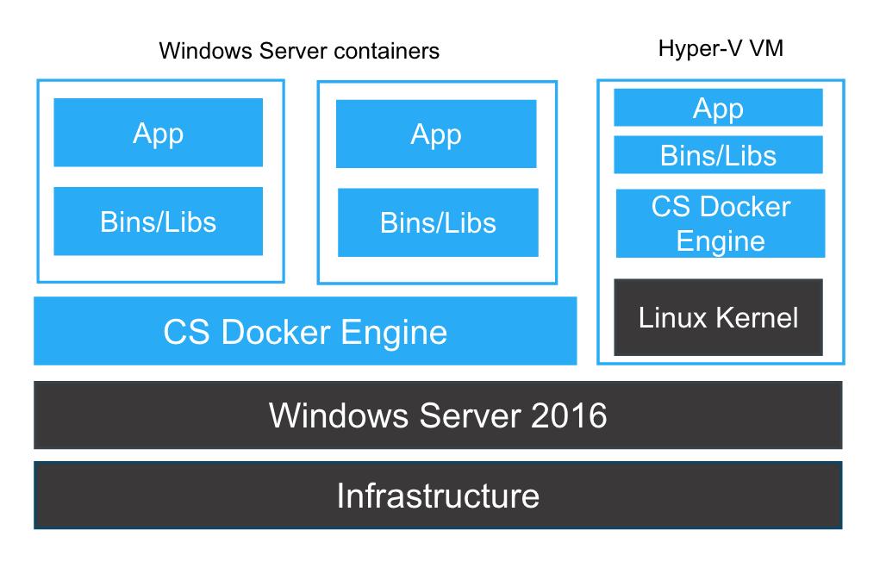
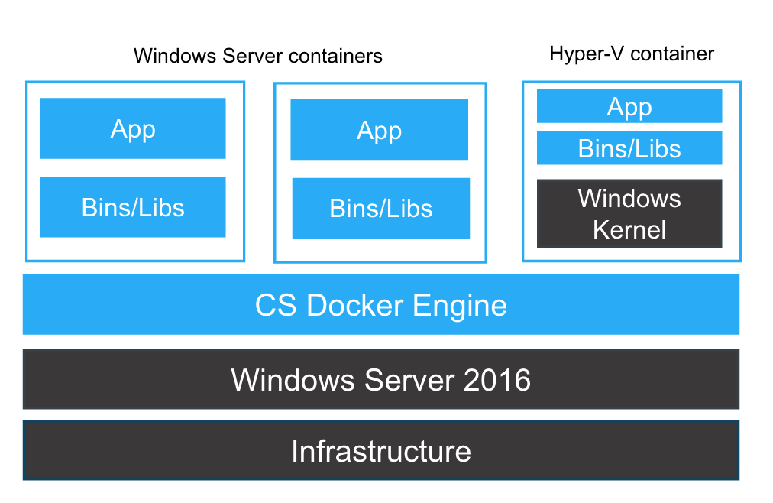
Docker for windows
https://docs.Docker.com/docker-for-windows/

Slide 11
Docker arm

Slide 12
Nvidia docker
GPU Processing

Slide 13

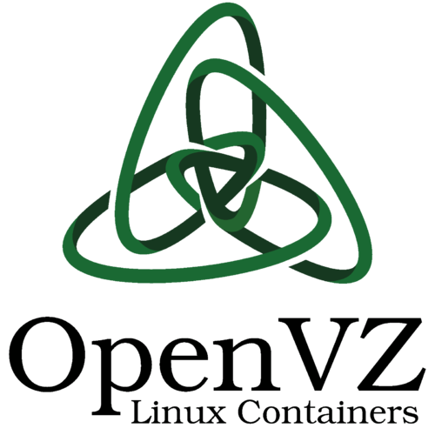



Other ENGINES containers
LXC / LXD

Slide 14
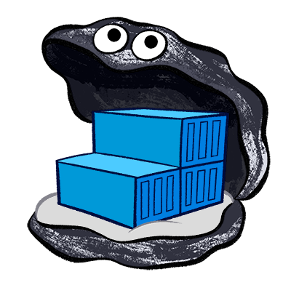
Docker image
Container template
Dockerfile
Build Dockerfile
# docker build –t <name> .
Docker Registry
Docker Hub

Slide 15
Docker image file
FROM python:alpine
RUN pip install flask
COPY hello.pyp / EXPOSE 5000
WORKDIR / ENTRYPOINT [“python”, “hello.py”]
Notes:
<number>

Slide 16

Hands on
download image
list image
create image
Tag
Historic
Layers
delete image

Slide 17
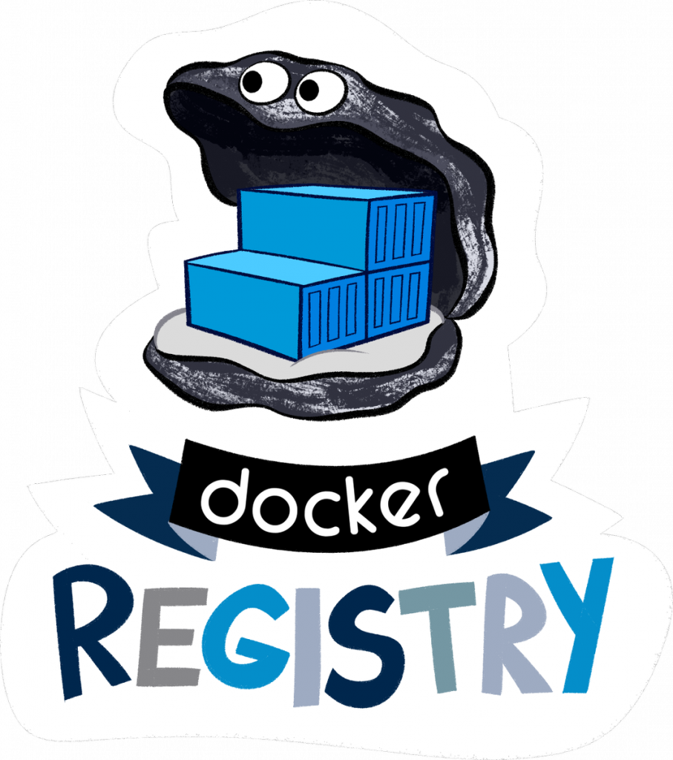
Docker registre AND docker hub
https://hub.Docker.com

Slide 18
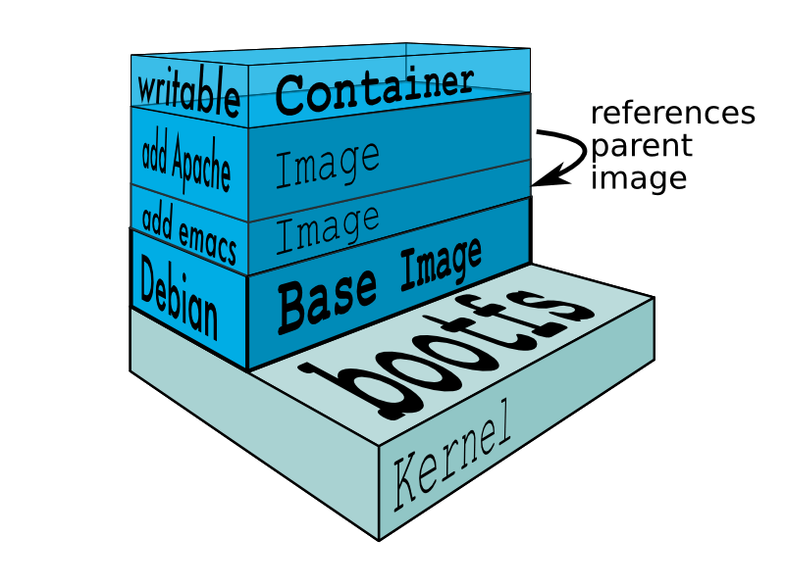
Containers docker
A container is a self-contained execution environment that shares the kernel of the host system and is (optionally) isolated from other containers on the system.
Copy-on-Write (COW)
Benefits

Slide 19
Hands oN
Create containers (ubuntu, Redis)
list containers
enter the container
Persistence (inside the container)
Volumes
network
Status
logs
Environment variables
delete container
Notes:
<number>

Slide 20
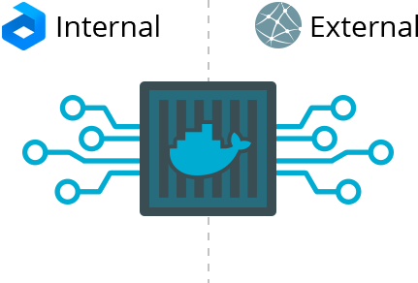
External accesses
Volumes
doors
network
Container access
Safety

Slide 21
Docker compose
Docker compose engine
What is it for? (Multiple Containers)
when to use
Yaml
Benefits

Slide 22
docker compose file
version: '3’
services: web:
build: . ports:
- "5000:5000"
redis:
image: "redis:alpine"

Slide 23
Hands on
create compose-file
list service
stop service
remove service

Slide 24
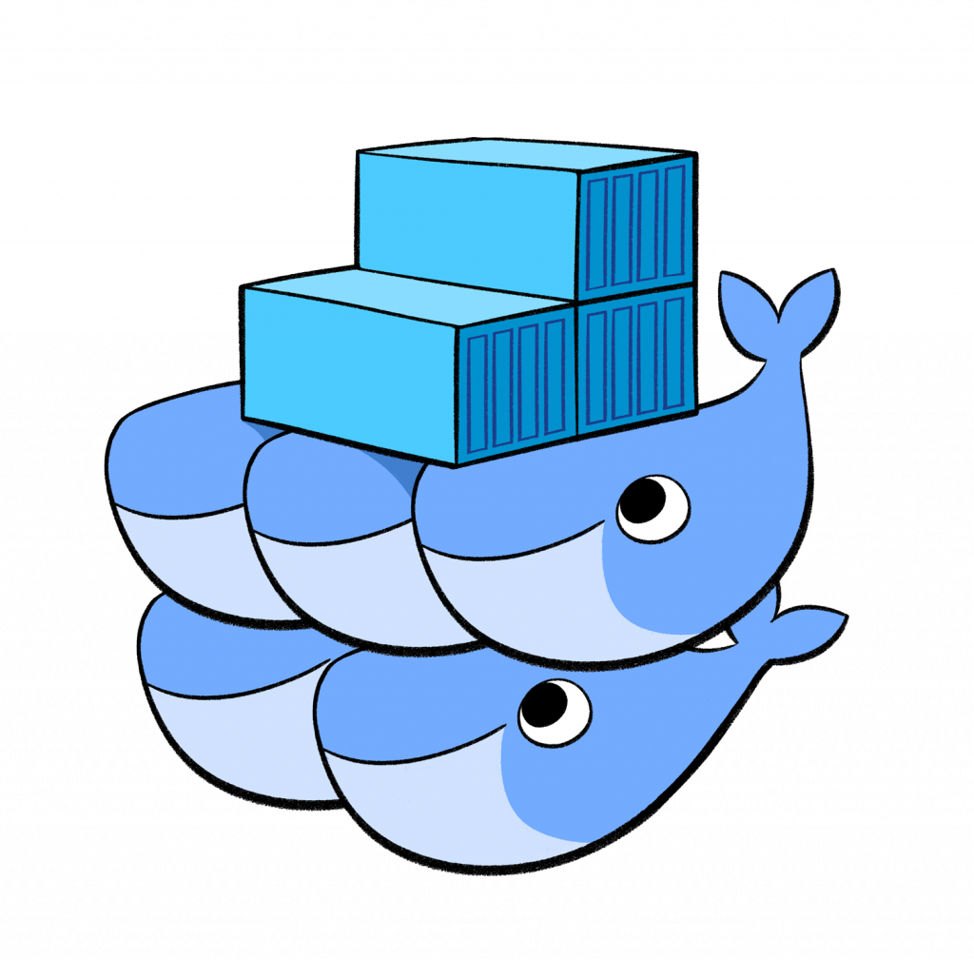
swarm
What is Swarm?
Because?
Compose file - Yaml
services

Slide 25
docker compose file
version: "3"
services:
web:
image: username/repo:tag
deploy:
replicas: 5
resources: l
imits:
cpus: "0.1"
memory: 50M
restart_policy:
condition: on-failure
ports:
- "4000:80"
networks:
- webnet
networks:
webnet:

Slide 26


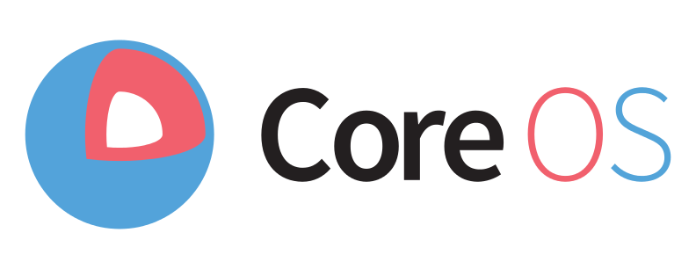


Orchestrators and Tools
Kubernetes
Mesosphere
CoreOS
Rancher
Portainer
EKS
GKE
OKE
OKE

Slide 27
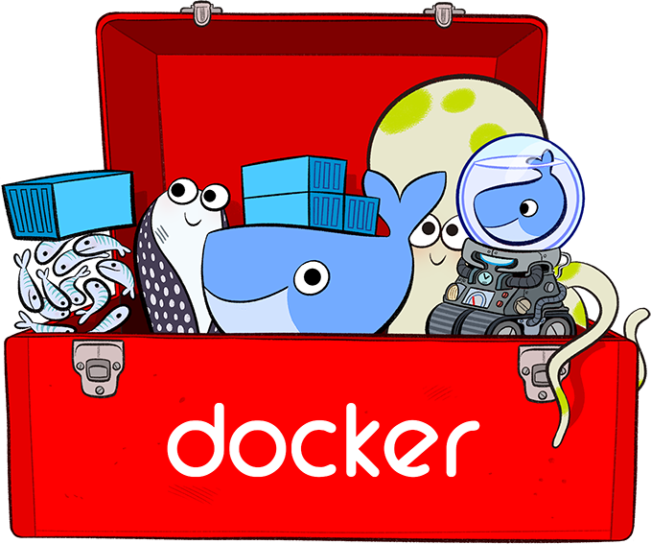
Stack docker

Slide 28

TIPs
12 (twelve) factor
recommendations to build
container/cloud friendly applications
http://12factor.net/
Docker container on Desktop
Desktop applications with docker https://blog.jessfraz.com/post/docker-containers-on-the-desktop/

Slide 29
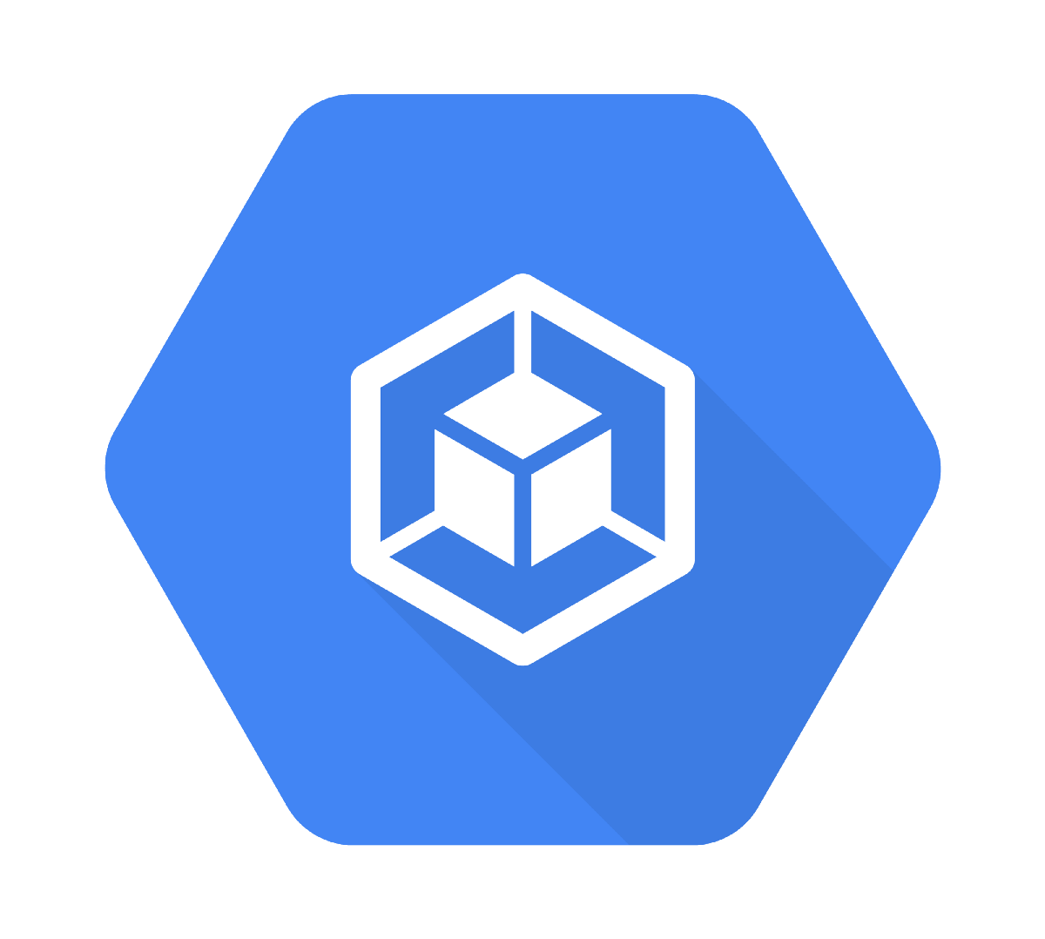

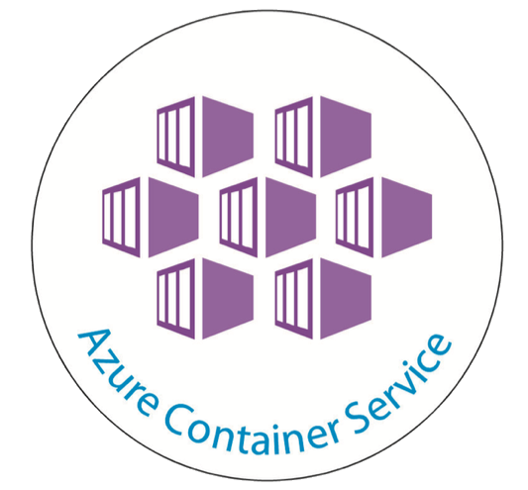
Container cloud
GCP - Container
Oracle Container Cloud

Slide 30




What else?
Serverless

Slide 31
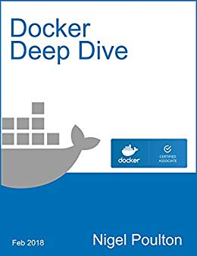
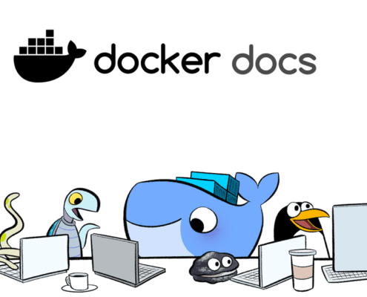
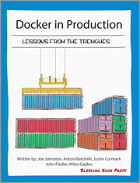
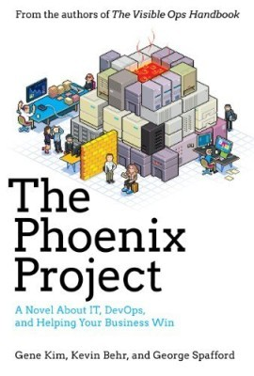
referências
http://docs.docker.com

Slide 32
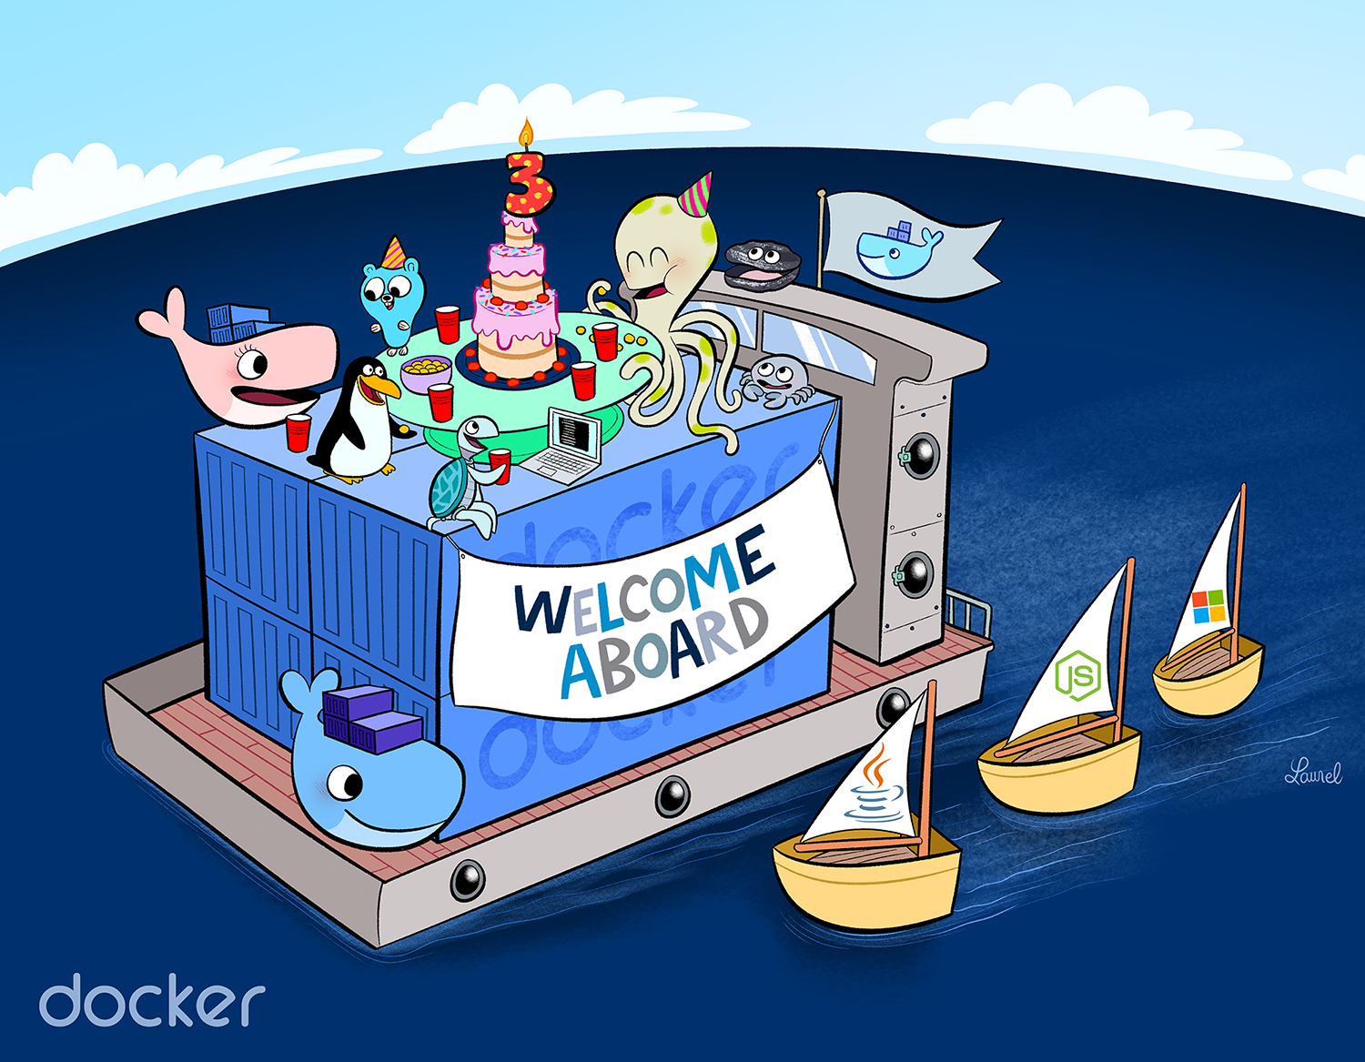
Obrigado!!!

